Slide 2
Chapter 4
Policy Analysis

Slide 3
Introduction
What is policy analysis? Why do it?
What are the steps in policy analysis?
Who does policy analysis and using what methods?
How is policy analysis different from the policy making cycle?

Slide 4
Thought Questions:
Consider the case of using cell phones while driving a car, whether for talking or texting.
Given the information provided in the chapter, would you favor restricting drivers’ use of handheld cell phones?
What about hands-free cell phones?
What about restrictions on texting?
How would you defend this policy choice?
Notes:
Consider the case of using cell phones while driving a car, whether for talking or texting. Given the information provided in the chapter, would you favor restricting drivers’ use of handheld cell phones? What about hands-free cell phones? What about restrictions on texting? How would you defend this policy choice?

Slide 5
What is Policy Analysis?
Definition: Collect and interpret information to clarify public problems and study consequences of policy actions
The study of:
  public problems
  proposed policy alternatives (most common use)
Purpose: to inform and develop understanding in order to make better policy
Notes:
Cell phone policy issue

Slide 6
Approaches to Policy Analysis
Rational-Comprehensive Approach
  Broad and thorough; time consuming
  Logical sequence of steps
    Define problem
    Set outcome goals
    Propose and evaluate alternatives
    Choose policy options
Incremental Approach
  Limited and gradual policy change
  Variety of methods

Slide 7
Why Do Policy Analysis?
Simply put: Better policy
It informs the whole cycle of policy making
  Emphasis on policy alternatives
When policy making is rushed, policy analysis gets shorted

Slide 8
Policy Analysis Is a Career Field
Proliferation of think tanks and policy analysis
  Complexity of issues
  Helpful to elected officials
  Advocacy
  Justify political positions
Brookings Institution
Pew Trust

Slide 9
U.S. Gun Violence:
The Need for Policy Analysis
Video: “Guns: a Public Health issue ” https://www.nytimes.com/video/us/100000004098000/guns-a-public-health-issue.html
December 24, 2015. A New York Times Interview with David Hemenway, director of the Harvard Injury Control Research Center, about the lack of research on gun violence since Congress stripped funding for it from the Centers for Disease Control and Prevention in the mid-1990s..(Time: 3:13)
Notes:
Use to discuss the importance of having solid data and information about gun violence and what policy options might help.
Video: https://www.youtube.com/watch?v=cyABmRboBi4 “Latest News: The gun numbers America doesn’t have.” February 15, 2013. A CNN interview by Christiane Amanpour with Dr. Mark Rosenberg of the CDC on the importance of analysis of gun violence data to understand the issue, in order to develop effective policies. (Time: 7:59)

Slide 10
What are the
Steps in Policy Analysis?

Slide 11
Steps in the Policy Analysis Process
Define and analyze the problem (Ch. 5)
Construct policy alternatives (Ch. 5)
Develop evaluative criteria (Ch. 6)
Assess policy alternatives (Ch. 6)
Draw conclusions (Ch. 6)

Slide 12
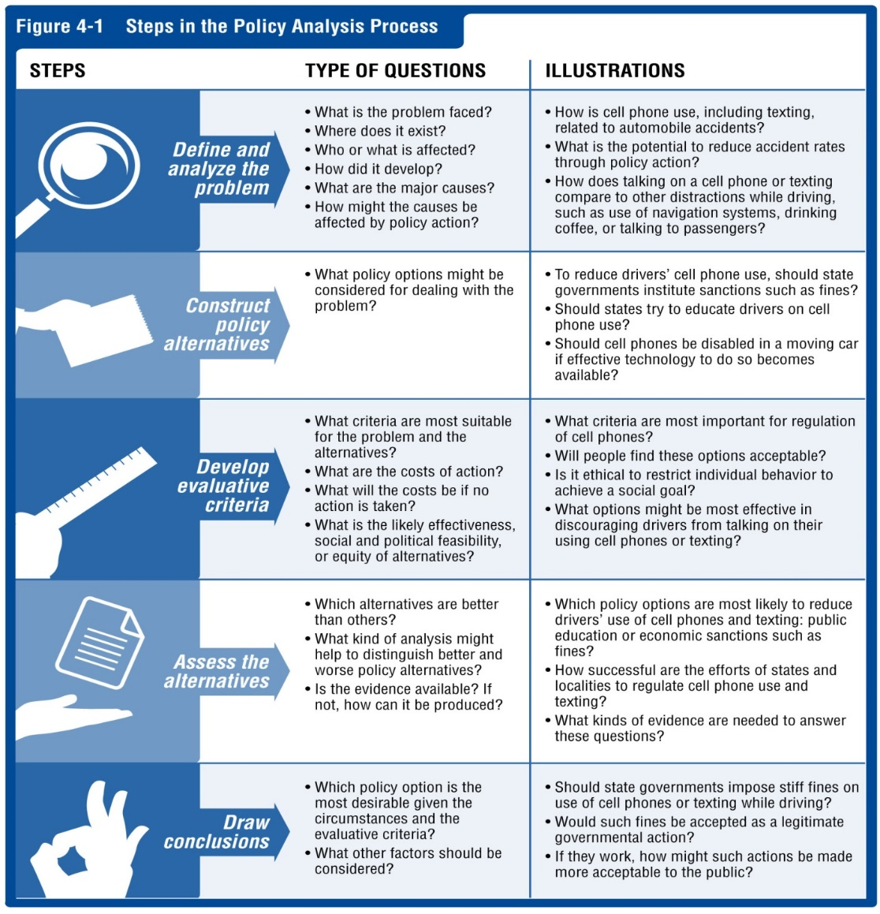

Slide 13
Wildfires in Western United States
Video: https://www.youtube.com/watch?v=4i2U0GipUbA

Slide 14
Define and Analyze the Societal Problem
What is the scope and severity of problem?
Where does it occur?
Who does it affect?
How did it develop?
How might the problem be changing?
Video: https://www.youtube.com/watch?v=4i2U0GipUbA
Notes:
Discuss how this problem might be researched by policy analysts.
https://www.youtube.com/watch?v=2nwZoV7dqoQ

Slide 15
Construct Policy Alternatives
What policy options might be considered to deal with the problem?
Consider the policy tools available such as regulation, government management, or public education.

Slide 16
Develop Evaluative Criteria
How should we choose the proper policy action(s)?
On what basis should we make our choice?
What is an alternative likely to cost?
Will the proposal be politically feasible?

Slide 17
Assess Policy Alternatives
Which alternative is likely to be most effective?
Which combination of policies might work well together?
What will the impact be on the problem of each course of action?

Slide 18
Draw Conclusions: Propose a Policy

Slide 19
What Methods Are Used in Policy Analysis?
Tools: research, modeling, hearings, debate
Disciplines/perspectives:
  Economics
  Political science
  Social work
  Psychology
  Other disciplines

Slide 20
Who Does Policy Analysis?

Slide 21
Policy Analysis Is Performed By
Government agencies (federal and state)
Universities
Think tanks
Interest groups

Slide 22
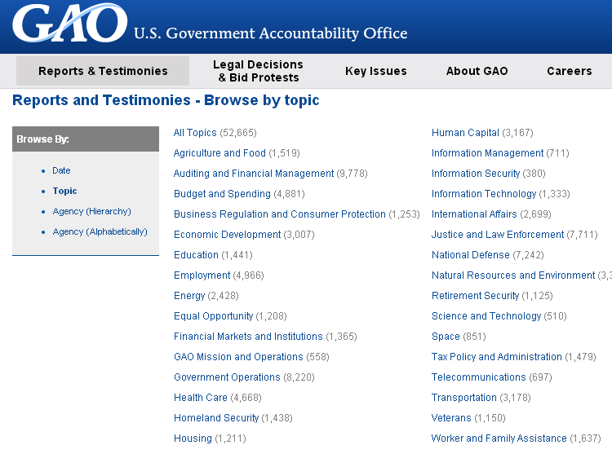
Governmental Policy Analysis
Notes:
Image/Webpage Source: http://www.gao.gov/browse/topic

Slide 23
Policy Analysis by Think Tanks
“Policy research institutes”—growing sector
  Small and specialized . . . Large and diverse
  Broad range of ideologies and ideals
    Brookings Institution (more left)
    American Enterprise Institute (more right)
Their work helps policymakers
  Understand complex problems
  Learn ways to address problems
  Understand views of interest groups

Slide 24
Policy Analysis by Interest Groups
Hold a definite position/bias
Focus on information that supports their case

Slide 25
Orientations to Policy Analysis
Scientific Approaches
Professional Approaches
Political Approaches

Slide 26
Scientific Orientation
Most rigorous; performed by academics
Deepen the understanding of public problems
Build theories

Slide 27
Professional Orientation
Objective and rigorous analysis
Purpose: to make decisions (not advance theory)
Analyze policy options
Pew Research Center: a nonpartisan, nonprofit think tank
Notes:
Link to the PewResearchCenter http://www.pewresearch.org/
Explore the various policy studies they do.

Slide 28
Political Orientation
Research that takes a position
  Still can be high quality
  Performed by interest groups to support their positions
Examples:
  Brookings Institute
  American Enterprise Institute

Slide 29
Approaches to Policy Analysis
Root Causes Versus Proximate Causes
  Study deeper underlying issues?
  Focus more on symptoms?
Discussion:
  What are the root causes of homelessness?
  What would policy addressing root cause look like?
  What are the proximate causes of homelessness?
  What would policy addressing proximate cause look like?

Slide 30
Approaches to Policy Analysis
Comprehensive Versus Short Term
  Elaborate and time consuming or focused and brief
Discussion:
  What would a comprehensive policy to address homelessness among veterans look like?
  What would a short-term policy look like?

Slide 31
Approaches to Policy Analysis
Consensual Versus Contentious
  Based on mainstream values or more radical?
Discussion:
  Should a city give homeless persons a home of their own and some aid to get their lives back together?
  Or should the city build a homeless shelter?
  Video: https://www.youtube.com/watch?v=IbBp1yMU7lE
  “Utah Ending Homelessness By Giving Away Homes.”
Notes:
Video: https://www.youtube.com/watch?v=IbBp1yMU7lE “Utah Ending Homelessness By Giving Away Homes.” Date Host Richard Fowler discusses an innovative Utah policy to end homelessness, along with reviewing other homelessness policy alternatives that are used in other states. Good example of a policy proposal that is innovative and possibly contentious. (Time: 2:30)

Slide 32
Approaches to Policy Analysis
Rational Versus Democratic?
  More rigorous or focused on engaging citizens?
Discussion:
    Should the city conduct a study of the reasons for homelessness?
    Or should the city set up a citizen advisory committee to decide what should be done?

Slide 33
How Is Policy Analysis Different Than the Policy Making Process?
Don’t Get Them Confused!

Slide 34
Policy Analysis Comes Into Play...
*Problem Definition & Agenda Setting
*Policy Evaluation and Change
*Policy Formulation
Policy Implementation
Policy Legitimation
Notes:
Dark blue squares show the places where policy analysis is especially needed

Slide 35
Wrap-Up
Policy analysis studies problems and possible solutions
It includes study of the problem and evaluating possible policy alternatives
It is done by academics and interest groups
Each policy analysis involves many choices regarding approach

